Slide 1
Unit 1
Instructor: Akshata Balghare
ENGL 1301
Texas Tech University

Slide 2


Why study “rhetoric”???????
Foundational for academic writing
Foundational for public deliberation
Inculcating habits of mind like curiosity, inquiry, listening, paying attention to detail.
Foundational for effective communication (being able to prove a point)
Understanding the reader/speaker/listener (their backgrounds)
Finding common grounds/drawing concessions

Slide 3
Public deliberation through social media
Jameela Jamil’s take on Avon
https://abcnews.go.com/GMA/Culture/jameela-jamil-shuts-body-shaming-avon-ad-company/story?id=60523346

Slide 4


Nigerian oil spill case study

Slide 5


Shell and Military combine forces

Slide 6
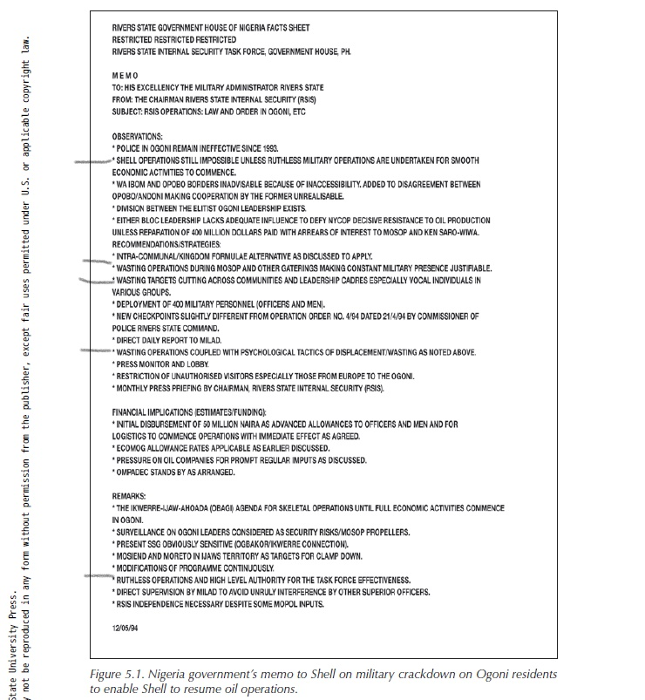
Memo written by Shell to Military

